Slide 1

Brain Imaging Analysis and Reporting System (Image based brain tumor detection using deep learning )
Group Members:
Nazim Sulman (20P-0639
Haris Ali (20P-0142)
Abdul Mohaiman (20P-0580)
Project Supervisor
Dr. Hafeez Anwar

Slide 2
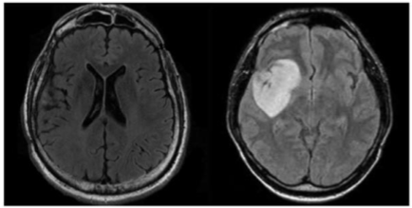
Introduction
Deep Learning with MRI Imaging
Methodology Overview:
Dataset acquisition
Preprocessing MRI scans
Training Deep learning models
Achieve brain tumor detection

Slide 3
Motivation
Address the need to revolutionize brain tumor detection which currently burden healthcare systems globally.
Manual interpretation of brain scans is slow, labor-intensive, and prone to errors despite advancements in imaging technology.
Implementation of deep learning based approaches could lead to quicker interventions and better outcomes for patients brain tumor detection.

Slide 4
Literature Review
Sr No | Year | Title | Methodology | Limitation
1) | 2022 | Accurate brain tumor detection using deep convolutional neural network | Deep learning models for identifying brain abnormalities as well as classifying different tumor grades, | The study may be limited by the availability and quality of the MRI dataset used for training the deep learning model.
2) | 2022 | Brain Tumor Classification and Detection Using Hybrid Deep Tumor Network | The paper presents a novel method for brain classification using machine learning algorithms and feature extraction techniques. | Limited validation on diverse datasets from different geographical locations and grid conditions.
3) | 2022 | Brain tumor MRI images identification and classification based on the recurrent convolutional neural network | Utilizes deep learning algorithms for semantic segmentation of brain tumor regions in MRI images. | May not account for potential variations in tumor appearance and characteristics across different patient populations.
4) | 2020 | Brain Tumor Identification and Classification of MRI images using deep learning techniques | Limited evaluation on real-world datasets and potential scalability issues. | The paper proposes a deep learning-based approach for video anomaly detection using spatio-temporal feature extraction and reconstruction.

Slide 5
Problem Statement
Timely, accurate brain tumor detection via enhanced MRI images using deep learning can improve diagnosis and treatment efficiency,overcoming limitations of traditional methods and radiologist dependence.

Slide 6
Solution
Comprehensive web-based software solution addressing the challenges in brain tumor detection.
It will encompass both front-end web development and seamless integration of Deep learning model for brain tumor detection.

Slide 7
UML Diagrams

Slide 8
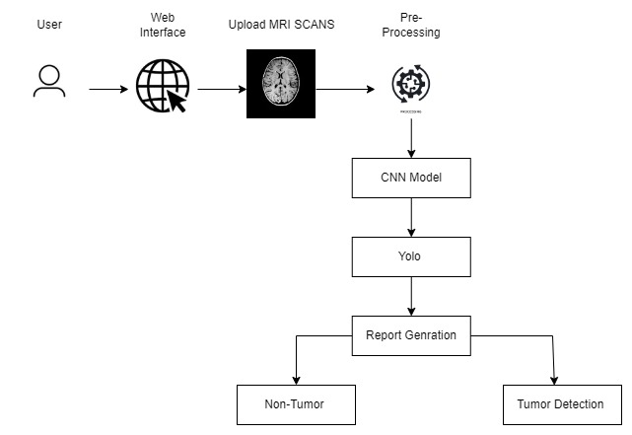
System Architecture

Slide 9
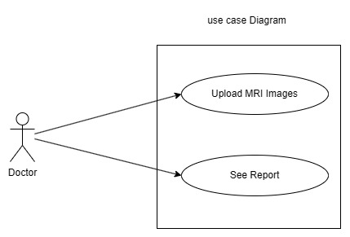
Use Case Diagram

Slide 10
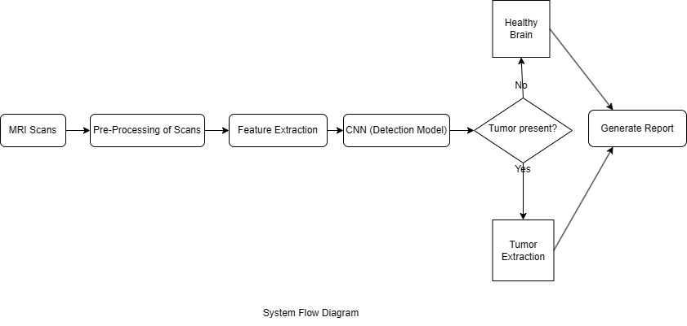
Flow Diagram

Slide 11
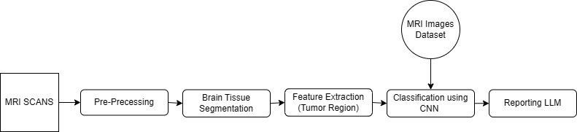
Block Diagram

Slide 12
Scope of the project
This project will greatly impact the medical field by introducing advanced techniques such as deep learning algorithm for image based brain tumor detection.
It aims to simplify decision-making for doctors for the treatment of patients.

Slide 13
Goals
Develop a user-friendly software to facilitate easier tumor detection for doctors, aiding in decision-making by precisely identifying abnormalities in brain images and pinpointing the location of tumors.

Slide 14
Dataset

Slide 15
Dataset
Dataset is sourced from Kaggle and from hospitals which were easy to share there patient data.
Date set contain scans of three types of Brain tumor Glioma,. Pituitary and Meningioma .
Dataset contain approximately 4500+ MRI scans for testing and training of CNN model for detection of Tumor.

Slide 16
Dataset
 | Total Images
GLIOMA | 911
MENINGIOMA | 1102
PITUITARY | 1240
No-Tumor | 1100

Slide 17
UI/UX

Slide 18
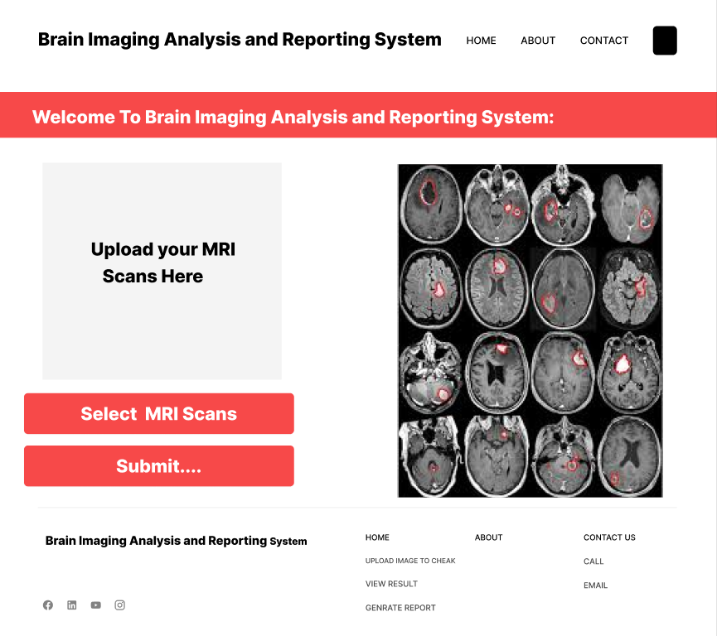
Home Page

Slide 19
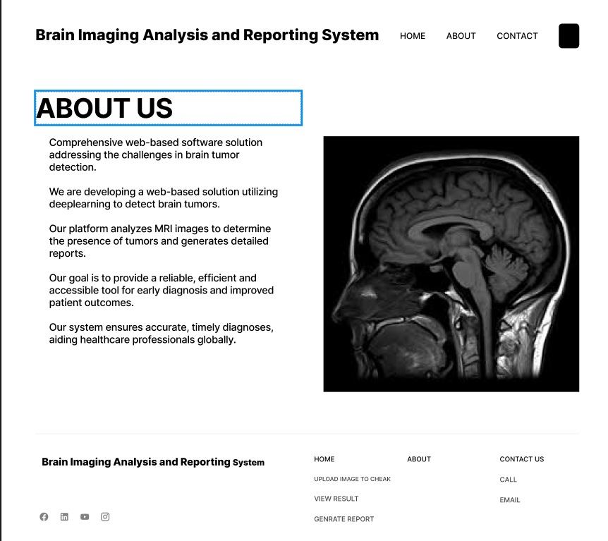
About Page:

Slide 20
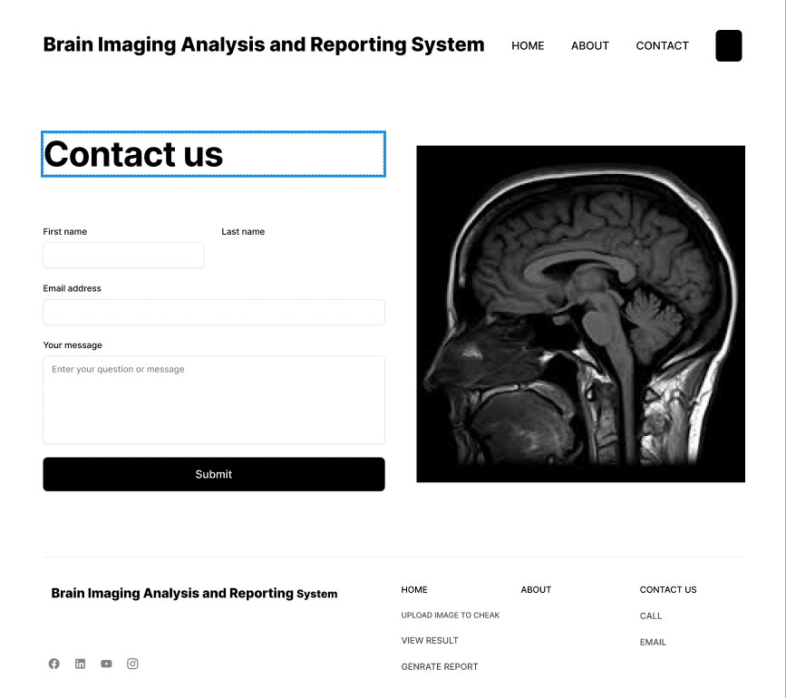
Contact Page:

Slide 21
Web Prototype

Slide 22
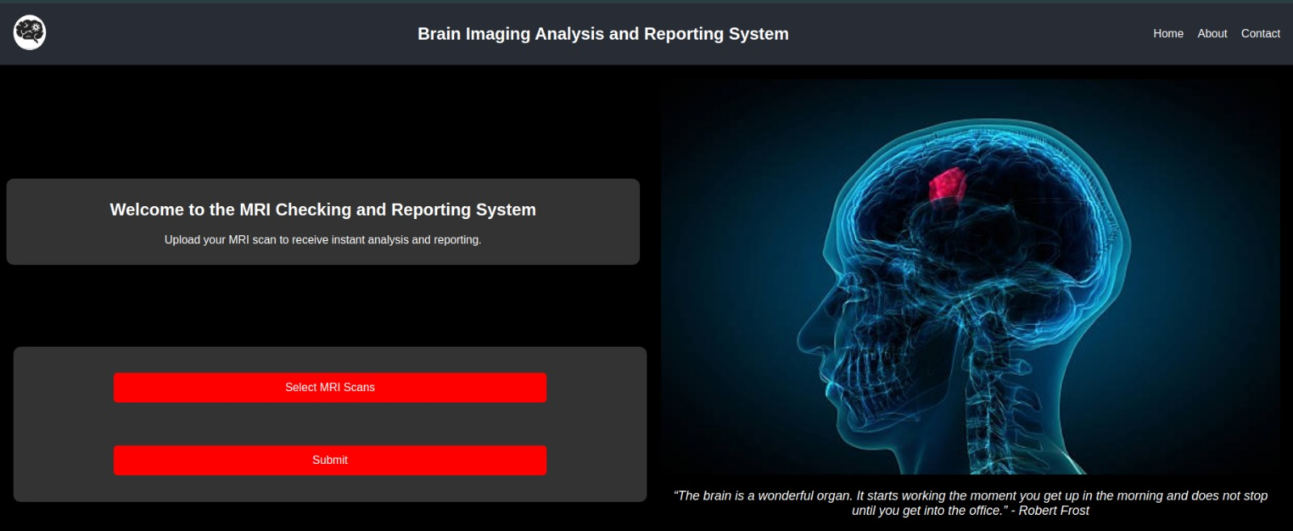

Slide 23
Model Information and Results

Slide 24
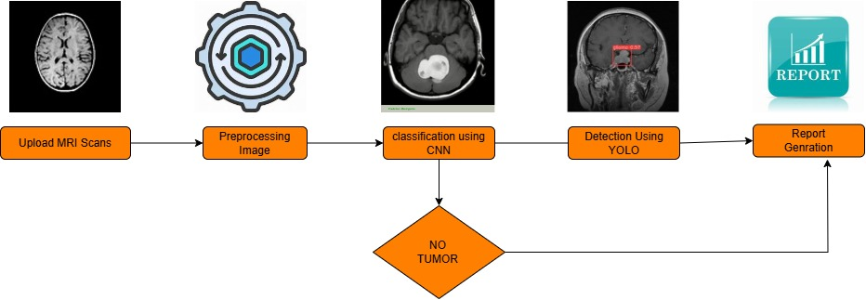
System Block Diagram
.

Slide 25
Classification and Detection Model
Classification Model:
We are using VGG16 as the primary model for classification.
.Detection Model:
For tumor detection and bounding box generation, we are using YOLOv8 .

Slide 26
Classification Model Architecture
VGG16 is known for its simplicity and depth, consisting of 16 layers .
Input Layer: 224x224 RGB image
Convolutional Layers:13 convolutional layers with filters of size 3x3, stride 1, and padding 1.Filter depths increase progressively from 64 to 512
Max-Pooling Layers: After every 2 convolutional layers, a 2x2 max-pooling layer is applied.
Fully Connected Layers : Two dense layers with 4096 neurons each. One dense layer with 1000 neurons
Output Layer: Soft max activation for class probabilities. .

Slide 27
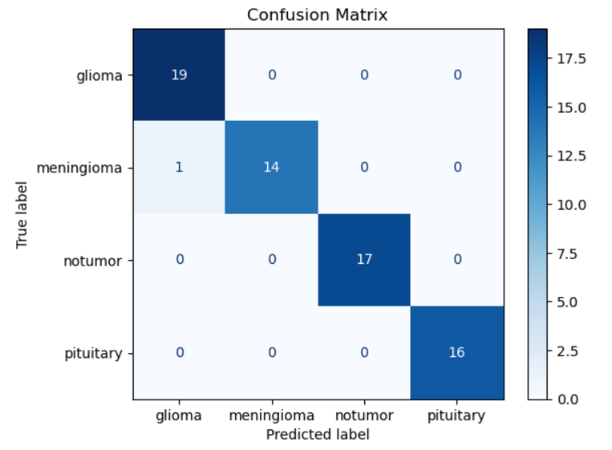
Classification Confusion Matrix

Slide 28
Classification Accuracy
 | GLIOMA | MENINGIOMA | PITUITARY | No-Tumor
Precision | 0.94 | 0.88 | 0.94 | 1.00
Recall | 0.94 | 0.83 | 1.00 | 1.00
F1-score | 0.89 | 0.90 | 0.97 | 1.00
Support | 19 | 15 | 17 | 16

Slide 29
Accuracy
 | Results
Training Loss | 0.19%
Training Accuracy | 99%
Validation Loss | 7.15%
Validation Accuracy | 98.51%

Slide 30
Detection Model Architecture
YOLOv8 is a more recent version of the YOLO and is optimized for speed and accuracy.
Backbone: A series of convolutional layers followed by activation functions . Utilizes CSP (Cross Stage Partial) connections to improve gradient flow. SPP (Spatial Pyramid Pooling) to improve receptive fields.
Neck: Path Aggregation Network (PAN) is used to enhance the feature map from the backbone by fusing low and high-level features
Head: Output predictions for bounding boxes, object confidence, and class probabilities. Uses anchor boxes for predicting bounding boxes.

Slide 31
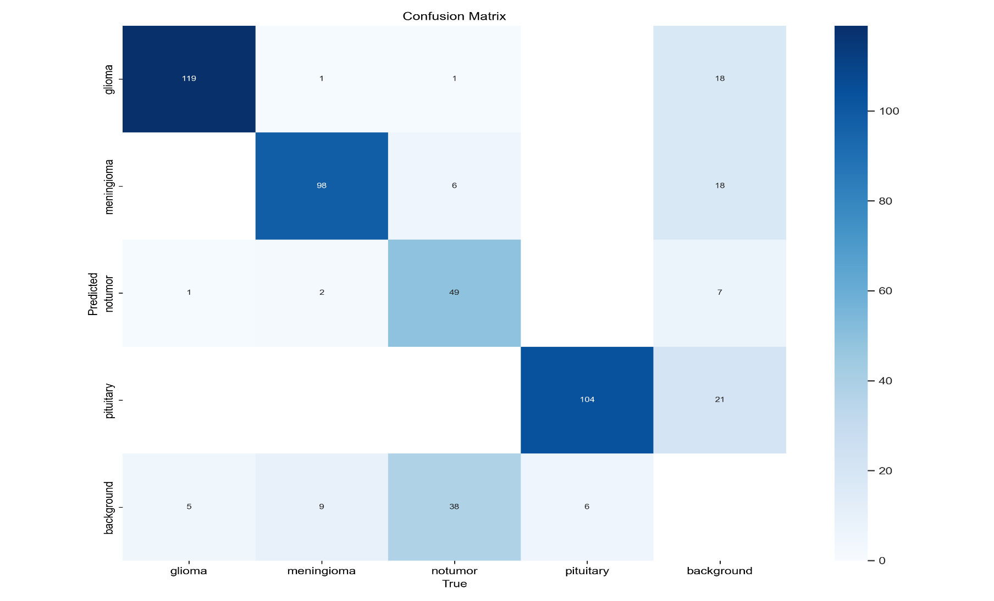
Detection Confusion Matrix

Slide 32
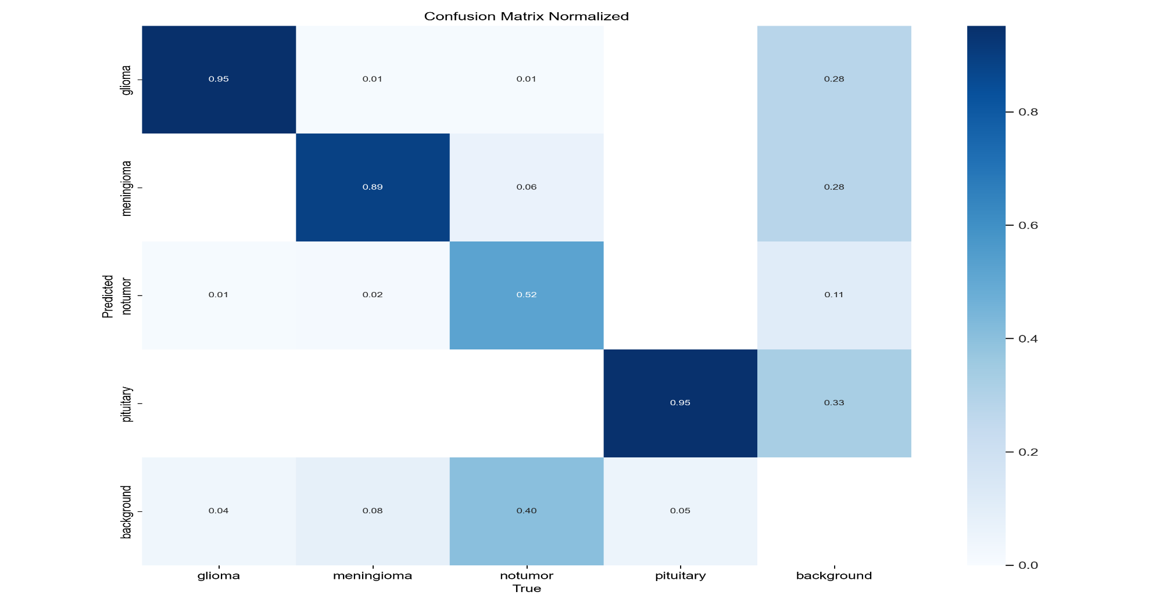
Detection Normalized Confusion Matrix

Slide 33
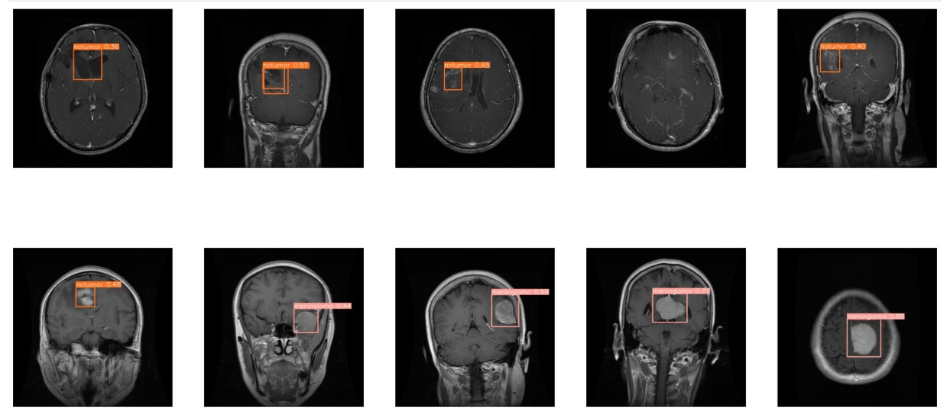
YOLO Detection Results:

Slide 34
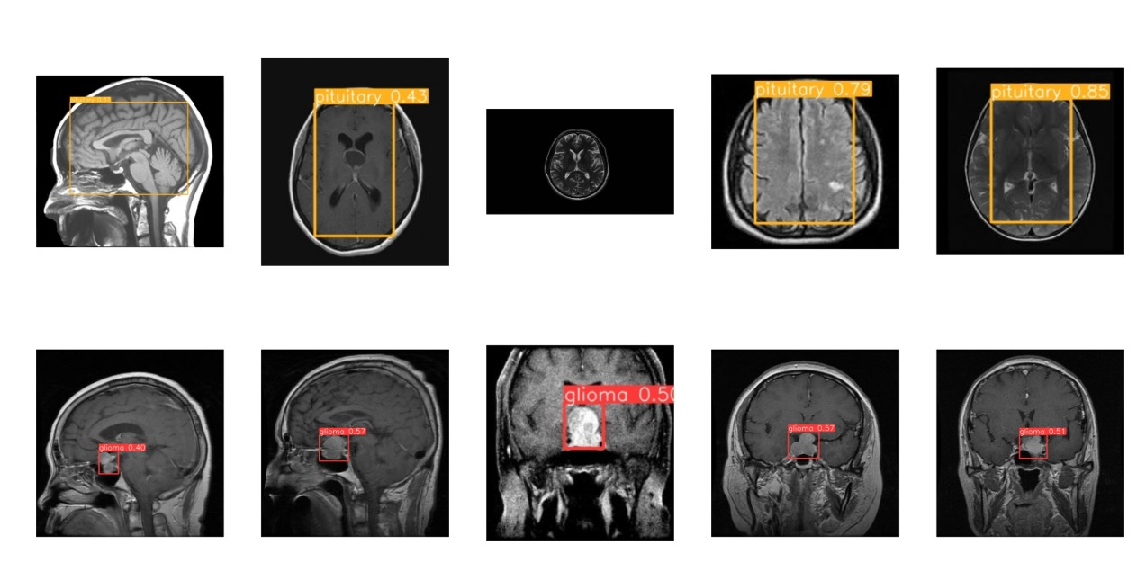
YOLO Detection Results

Slide 35
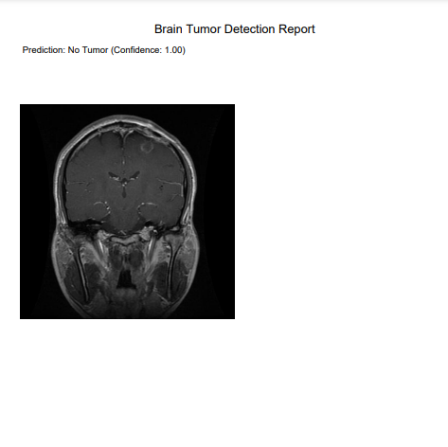
Report Result With No Tumor

Slide 36
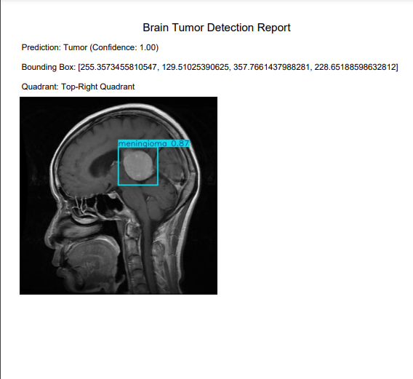
Report Result With Tumor

Slide 37
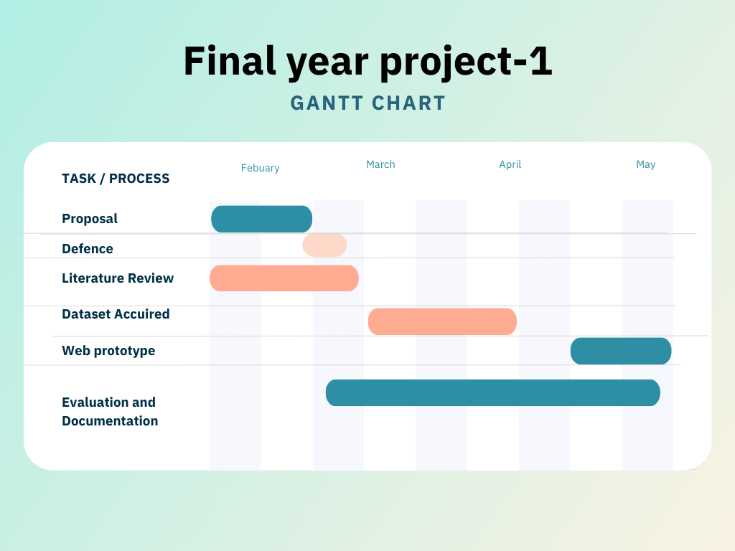
Objectives

Slide 38
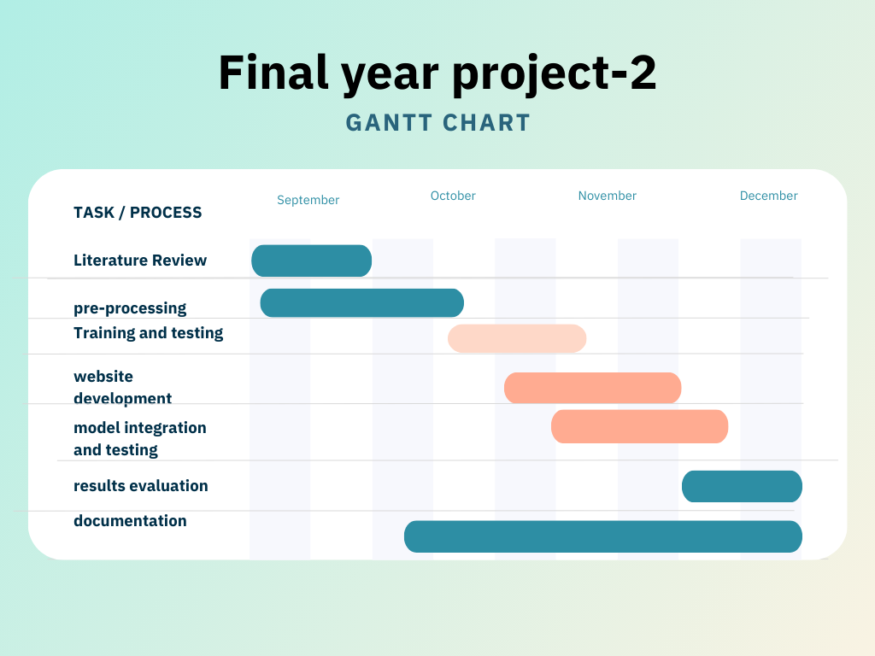
Objectives

Slide 39
Expected Result
At the completion of this project we will see a complete Web based software which will be helpful in brain tumor detection using Deep learning algorithms and generate a report by uploading the MRI scans.

Slide 40
Team Work
We finalized our idea.
The documentation and literature review will be done equally.
The collection of MRI scans and dataset by Haris.
Ensuring proper data labeling and annotation and performing data preprocessing and classification done sulman and Haris.
Normalizing and data augmentation by sulman.
Designing a prototype of web based application by NazimSsulman and Haris Ali.
Project documentation, Preparing figures for presentations and reports and SDA diagram by Haris and Mohiman.

Slide 41
References
Md. Saikat Islam, “Accurate brain tumor detection using deep convolutional neural network” Khan, Computational and Structural Biotechnology Journal, Volume 20, 4733 – 4745, 2022
A. Smith, “Brain Segment Classification on anomaly detection Using Machine Learning Techniques" IEEE Access, 2022.
Deyun Chen, "Deep Learning-Based Semantic Segmentation for Brain Tumor Detection in MRI Images," IEEE Transactions on Medical Imaging, 2022.
Zheshu Jia, "Brain Tumor Identification and Classification of MRI images using deep learning techniques " IEEE Access, 2020.

